Slide 1
Chapter 2: The Physical Layer
1 What is the basic goal of the physical layer?
物理层的基本目标是什么？
2 How to define the physical layer protocols?
如何定义物理层的协议
3 What is the theoretical basis for the physical layer?
物理层的理论基础是什么？
*4 What are the commonly used transmission media?
常用的传输介质有哪些？
*5 What are the common physical layer interface standards?
常见的物理层接口标准有哪些？

Slide 2
Keypoints and Difficulties
Keypoints:
Nyquist's Law and Shannon-Hartley theorem
奈奎斯特定律和香农-哈特利定理
Symbol code types: NRZ, Manchester encoding, Differential Manchester encoding
符号编码类型 NRZ、曼彻斯特编码、差分曼彻斯特编码
Difficulties:
Channel transmission rate calculation
信道传输速率计算

Slide 3
1 The Goals
To ensure the correctness of the transmitted signals "0" and "1" and the consistency of transmission and reception;确保传输信号 "0 "和 "1 "的正确性以及传输和接收的一致性
Bit – transmission mode, speed, duration, and signal distortion;比特 - 传输模式、速度、持续时间和信号失真；
Interface design: the number of pins, specifications, functions, etc.;接口设计：引脚数量、规格、功能等；
Signal transmission procedures: how to arrange the transmission process and the order of events;
信号传输程序：如何安排传输过程和事件顺序；

Slide 4
Four Important Characteristics
Mechanical Characteristics机械特性
  Specifies the size of the connector used in the physical connection, the number and arrangement of pins.
指定物理连接中使用的连接器尺寸、针脚数量和排列。
Electrical Characteristics电气特性
  Specifies the transmission mode, voltage level, coding, impedance matching, transmission rate and distance limit when transmitting the binary bit.指定传输二进制位时的传输模式、电压电平、编码、阻抗匹配、传输速率和距离限制。

Slide 5
Four Important Characteristics
Functional Characteristics功能特点
  Define the function of each physical line, indicating the means of a special voltage appears on a line定义每条物理线路的功能，说明线路上出现特殊电压的手段
  Line functions are divided into four categories: Data, Control, Timing, Power Supply线路功能分为四类： 数据、控制、计时、供电
Procedural Characteristics程序特点
  Define the working rules and timing relationships for each physical line定义每条物理线路的工作规则和时序关系
  Signal transmission: simplex, half duplex, full duplex
  信号传输：单工、半双工、全双工

Slide 6
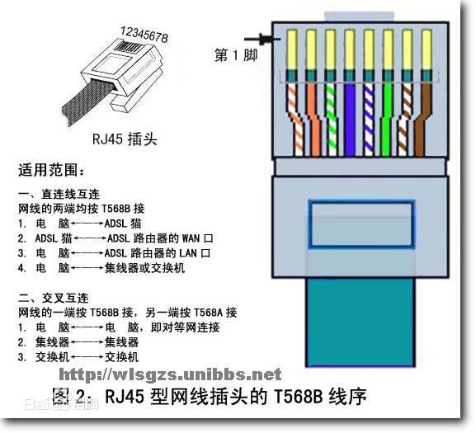
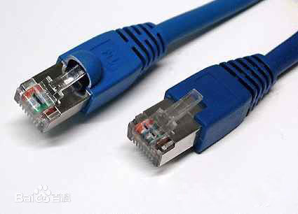
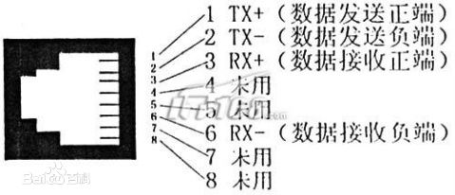


Slide 7

2 Contents of Physical Layer Protocol
Responsible for reliably transmitting bit data from one end of the physical medium to the other负责将比特数据从物理介质的一端可靠地传输到另一端

Slide 8
3 Basic theory of data communication
(1) Basic concepts
(2) For a specific physical communication channel, what is the maximum transmission rate? Infinite?
对于特定的物理通信信道，最大传输速率是多少？无限大？
(3) How to transmit Bits in specific physical communication channels? Transmission speed, transmission duration, signal distortion?如何在特定物理通信信道中传输比特？传输速度、传输持续时间、信号失真？
(4) In order to save communication equipment and costs, how to transmit the information of multiple computers in one physical channel?为了节省通信设备和成本，如何在一个物理信道中传输多台计算机的信息？

Slide 9
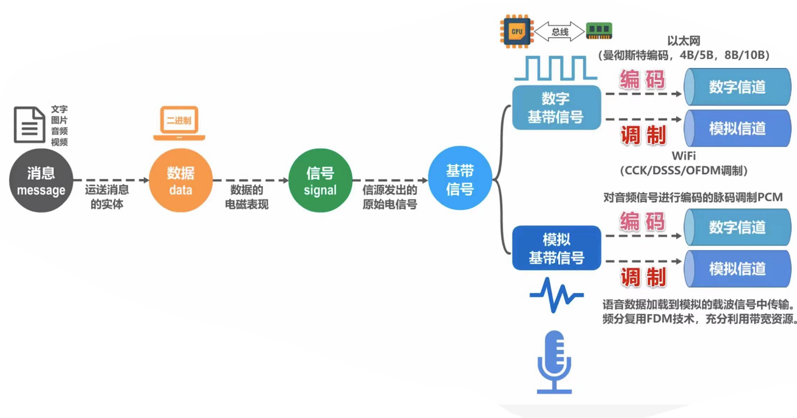
（1）Basic concepts
Data： Physical symbols describing objective facts
数据：描述客观事实的物理信号
Signal： Form of data transmission process
信号： 数据传输过程的形式
Channel: media that sends information in a certain direction渠道：向特定方向发送信息的媒介

Slide 10
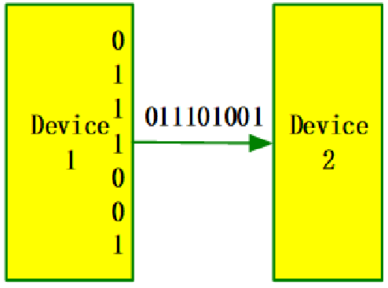
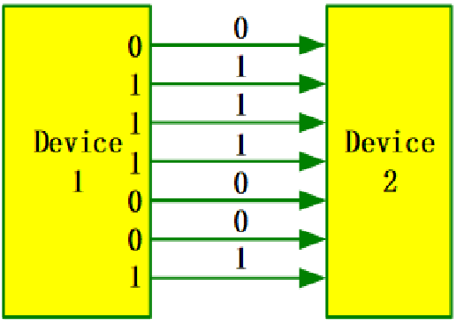
(1) Basic concepts
Serial transmission串行传输
Parallel transmission并行传输
Suitable for long distance communication适合长距离
Suitable for short distance communication适合短距离

Slide 11
(1) Basic concepts

Slide 12
3 Basic theory of data communication
(1) Basic concepts
(2) For a specific physical communication channel, what is the maximum transmission rate? Infinite?
(3) How to transmit Bits in specific physical communication channels? Transmission speed, transmission duration, signal distortion?
(4) In order to save communication equipment and costs, how to transmit the information of multiple computers in one physical channel?

Slide 13
(2) Channel Characteristics
Symbol: A digital pulse, which represents the basic waveform of a discrete value码元 数字脉冲，代表离散值的基本波形
  ASCII code of letter ‘A’: 1000001, can be represented by 7 pulses/symbols例如A的ASCII码，脉冲二进制
The amount of information carried by a symbol is determined by the number of discrete values taken by the symbol一个符号所承载的信息量取决于该符号所取离散值的数量
  Two discrete values (“0” or “1”): 1 bit码元取0，1两个离散值，一个码元携带1bit信息
  Four discrete values for a symbol: 2 bits
  If N discrete values for a symbol of n (bits), then
n = log₂N

Slide 14
(2) Channel Characteristics
Baud rate (modulation rate or symbol rate)：波特率
  The number of times the signal changes every second
  信号每秒变化的次数，也称为调制速率、码元速率
    1 baud sends one symbol per second1波特为每秒传送1个码元
Bit rate：比特率
  The number of bits transmitted per second每秒传送的二进制位数
Relationship between them:两者的关系
  If each symbol has n bits: bit rate (b/s) = baud rate * n
  If each symbol has 3 bits, then the bit rate is three times the baud rate
  If each symbol has 1 bit, the bit rate and baud rate are the same

Slide 15
(2) Channel Characteristics
Channel capacity (bandwidth in networks)信道容量
  The maximum number of bits that can be transmitted over a channel per unit time, expressed in bps单位时间内信道上所能传输的最大bit数
Frequency bandwidth (in communication)频带宽
  Frequency range of the signal allowed by the channel (= maximum frequency - minimum frequency), in Hz 信道所允许它通过信号的频率范围
  E.g., people can hear sound waves of 20Hz ~ 20kHz, i.e., frequency bandwidth of hearing system is19980Hz

Slide 16
(2) Channel Characteristics
Nyquist‘s Law :奈奎斯特
  1) For an ideal low-pass channel with the frequency bandwidth of W (Hz), its maximum symbol transmission rate = 2W Baud理想低通信道下最高码元传输速率=2w Baud
  2) For an ideal band-pass channel with the frequency bandwidth of W (Hz), its maximum symbol transmission rate = W Baud理想带通信道
Question
  The frequency band of a standard telephone channel is 300 ~ 3400Hz, i.e., the frequency bandwidth is 3100Hz. What is the maximum symbol transmission rate through the ideal low-pass channel?
  任何实际信道都不是理想的，在传输信号时会产生各种失真以及带来多种干扰。码元传输的速率越高，或信号传输的距离越远，在信道的输出端的波形的是真就越严重

Slide 17
(2) Channel Characteristics
Actual channels are not ideal – Distortion exists
  Higher symbol transmission rate高速
  Farther signal transmission distance远距
Small and recognizable distortion有失真，但可识别
Large and unrecognizable distortion失真大，无法识别
Larger distortion

Slide 18
(2) Channel Characteristics
Nyquist's Law :
  1) For an ideal low-pass channel with the frequency bandwidth of W (Hz), its maximum symbol transmission rate = 2W Baud
  2) For an ideal band-pass channel with the frequency bandwidth of W (Hz), its maximum symbol transmission rate = W Baud
Question
  The frequency band of a standard telephone channel is 300 ~ 3400Hz, i.e., the frequency bandwidth is 3100Hz. What is the maximum symbol transmission rate through the ideal low-pass channel?

Slide 19
(2) Channel Characteristics
Shannon’s Formula: limit information transmission rate C of channel can be expressed as:信道的极限信息传输速率C可表示为
  W - Frequency bandwidth in Hz信道频带宽
  S - Average signal power through the channel信道内所传信号的平均功率
  N - Gaussian noise power through the channel信道内部高斯噪声功率
  S/N – related to signal-to-noise ratio信噪比
    Typically in db (decibels):
Actual rate much lower than C due to signal loss
Possible to achieve error-free transmission as long as transmission rate < C只要小于极限就可以实现无差错传输
C = Wlog₂(1+S/N)
10 log₁₀S/N

Slide 20
(2) Channel Characteristics
Example:
  For the standard telephone channel with frequency bandwidth of 3.1 kHz, if the signal-to-noise ratio S/N = 2500, then can the information transmission rate be 50kb/s?
Solution:
  Put W = 3.1kHz, S / N = 2500 into Shannon’s Formula
  The limit information transmission rate is 35kb/s, so it is impossible to reach 50kb/s
In order to achieve 50kb/s, you can
  improve the signal-to-noise ratio in the channel
  or increase the frequency bandwidth

Slide 21
3 Basic theory of data communication
(1) Basic concepts
(2) For a specific physical communication channel, what is the maximum transmission rate? Infinite?
(3) How to transmit Bits in specific physical communication channels? Transmission speed, transmission duration, signal distortion?
(4) In order to save communication equipment and costs, how to transmit the information of multiple computers in one physical channel?

Slide 22
Techniques in analog/digital transmission
跳频、扩频、调制
PCM编码
数字编码

Slide 23
Modulation / demodulation system model
调制/解调系统模型
载波信号

Slide 24

Coding / decoding system model
编码/解码系统模型
x(t)
Digital signal
g(t)
g(t)
Encoder
Decoder
Digital or
Analog data
Digital channel
Digital or
Analog data
coding
decoding
sender
receiver

Slide 25
Modulation
(digital data to analog signals)
调制技术
Digital and carrier signals
Amplitude Modulation (AM)调幅，载波的振幅随基带数字信号变化
（ASK）

Slide 26

Modulation
(digital data to analog signals)
Frequency Modulation (FM)调频，载波频率随基带数字信号变化（FSK）
Phase Modulation (PM)调相，载波初始相位···（PSK）

Slide 27
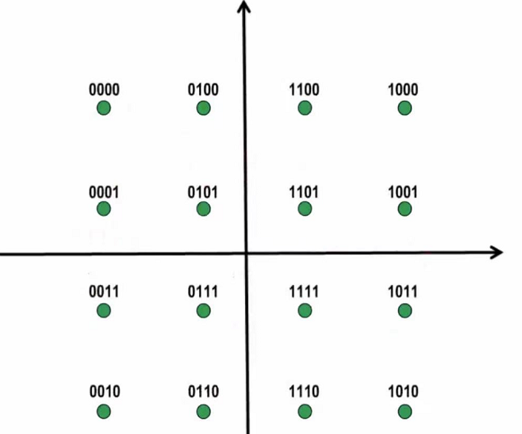
Modulation
(digital data to analog signals)
Quadrature Amplitude Modulation (QAM)正交条幅QAM技术
  PM and AM techniques结合调相和调幅技术
  If there are x changes in phase and y changes in amplitude, then there are x * y combined changes
  QAM星座表
4-QAM constellation table
16-QAM constellation table

Slide 28
Pulse Code Modulation (PCM)脉冲编码调制，PCM技术
(analog data to digital signals)
Sampling Theorem
  As long as the sampling frequency is not less than twice the maximum frequency of the signal, the original signal can be recovered from the sampling pulse without distortion
PCM system model采样、量化、编码

Slide 29
Pulse Code Modulation (PCM)
(analog data to digital signals)
Voice signal digitization语音信号数字化
  Voice frequency bandwidth f <4kHz
  Sampling clock frequency: 8kHz (> 2 times the maximum voice frequency)
  Sample quantization series: 256 (8bit / per sample)
  Data rate: 8000 times / s * 8bit = 64kb / s
  The rate of each PCM signal = 64kb / s

Slide 30
Pulse Code Modulation (PCM)
(analog data to digital signals)
PCM coding process example

Slide 31
Digital signal coding
(digital data to digital signals)
Non-Return-to-Zero (NRZ)不归零编码
Manchester encoding曼彻斯特编码
Differential Manchester encoding差分曼彻斯特编码
Block encoding (4B / 5B, 8B / 10B)块编码

Slide 32
Digital signal coding
(digital data to digital signals)
Non-Return-To-Zero Level (NRZ-L) Coding
低电平表示二进制0，高电平表示二进制1

Slide 33
Digital signal coding
(digital data to digital signals)
Disadvantages of NRZ-L
  Difficult to tell the end of one and the beginning of another难以分辨一位的结束和另一位的开始
  The sender and the receiver must have clock synchronization发送方和接收方必须有时钟同步
  If the signal “0” or “1” appears continuously, the signal DC component will accumulate0，1连续出现时，直流分量会累加
  Prone to propagation errors容易产生传播错误

Slide 34
Bit synchronization位同步：
  The purpose is to synchronize each bit of information received by the receiver with the sender接收端接受的每一位消息都与发送端同步
External synchronization
  发送端发送数据前发送同步脉冲信号，接收方用接收到的同步信号锁定时钟频率
Self-synchronization
通过特殊编码使数据编码信号中包含同步信号，接收方从数据编码信号提取同步信号来锁定自己的时钟脉冲频率

Slide 35
Digital signal coding
(digital data to digital signals)
Manchester Coding
  Each symbol is divided into two equal intervals
    "1": the previous interval is high and the next low
    "0": the previous interval is low and the next high
  Feature: A level hop in the middle time of each symbol

Slide 36
Digital signal coding 数字编码技术
(digital data to digital signals)
Advantages
  Overcoming the disadvantages of the NRZ Coding
  Each jump in the middle of a symbol can be used as data, and also as a clock for self-synchronization
Disadvantages
  Doubling the frequency bandwidth requirement of the transmission channel
  High-frequency noise also increases – susceptible to noise interference
  Ambiguous

Slide 37
Digital signal coding
(digital data to digital signals)
Differential Manchester Coding
  "1": the level of the first half of the symbol is the same as the level of the second half of the previous symbol
  "0": the level of the first half of the symbol is opposite to the level of the second half of the previous symbol
Regardless of whether the previous bit is 1 or 0
  Waveform 1
  Assuming the previous bit rises from low to high
  Waveform 2
  Assuming the previous bit drops from high to low

Slide 38
Digital signal coding
(digital data to digital signals)
Advantages
  Regardless of whether the symbol is "1" or "0", there must be a level hop in the middle of each symbol => better anti–interference performance
  Separation between bit clock and data => easy data extraction
  Transition uniquely determined by the second half of the previous symbol => ambiguity eliminated
Disadvantages
  Doubling the frequency bandwidth requirement of the transmission channel
  High-frequency noise also increases – susceptible to noise interference

Slide 39
Digital signal coding
(digital data to digital signals)
Exercise:
Draw the waveform of "001101" with
  NRZ-L
  Manchester Coding
  Differential Manchester Coding

Slide 40
Digital signal coding
(digital data to digital signals)
Block Coding
  Advantages
    Can improve the coding efficiency, reduce the modulation rate, and reduce the transmission line requirements可以提高编码效率，降低调制速率，降低对传输线路的要求
    Some redundant bits can be added for error detection or synchronization可增加一些冗余位，用于检错或同步。
  Applications
    4B / 5B (FDDI, 100M Fast Ethernet)
    8B / 10B (Gigabit Ethernet)

Slide 41
Digital signal coding
(digital data to digital signals)
Steps (mB / nB, m < n)：
Grouping 分组，数据比特序列划分为m位的多个比特序列
Substitution置换
n位置换m位，多出的比特序列可以用来检错、同步或其他控制功能
  The extra bit sequence can be used for
    error detection
    synchronization
    or other controls
  or not used
Line coding线路编码：使用一种简单的线路编码机制来生成信号

Slide 42
3 Basic theory of data communication
(1) Basic concepts
(2) For a specific physical communication channel, what is the maximum transmission rate? Infinite?
(3) How to transmit Bits in specific physical communication channels? Transmission speed, transmission duration, signal distortion?
(4) In order to save communication equipment and costs, how to transmit the information of multiple computers in one physical channel?

Slide 43
Multiplexing (Multi-pass)多路复用技术/多路共传
To send multiple sources of information in one physical channel at the same time一条物理通道传多路信息
Commonly used techniques
  Frequency division multiplexing (FDM) 频分复用
  Time division multiplexing (TDM)时分复用
  Wavelength division multiplexing (WDM)波分复用
  Code division multiplexing (CDM)码分复用

Slide 44
*Multiplexing : FDMA
FDMA: frequency division multiple access
channel spectrum divided into frequency bands
each station assigned fixed frequency band
unused transmission time in frequency bands go idle
example: 6-station LAN, 1,3,4 have pkt, frequency bands 2,5,6 idle
time
frequency bands
FDM cable

Slide 45
*Multiplexing : Orthogonal frequency division multiplexing (OFDM) technology
Basic principle:
  Dividing the channel into a number of orthogonal sub-channels;将多路不同信号的频率调制到不同的频率范围。
  The high-speed serial data is decomposed into multiple parallel low-speed data, the use of multi-carrier FDM method to transfer, that is, the data allocated to a large number of sub-channels for transmission.将高速串行数据分解成多个并行的低速数据，利用多载波 FDM 方法进行传输，即把数据分配给大量子信道进行传输。
Suitable for the high-speed data transmission through wireless channel under the presence of multipath propagation and Doppler shift.适合在存在多径传播和多普勒频移的情况下，通过无线信道进行高速数据传输。

Slide 46
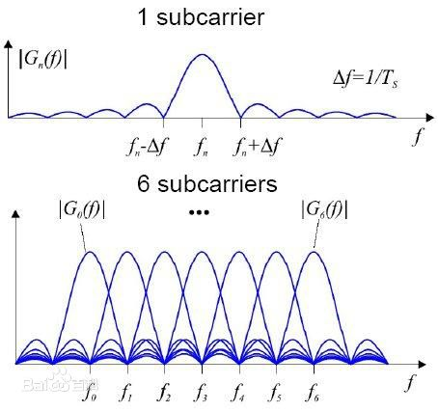
*Multiplexing : Orthogonal frequency division multiplexing (OFDM) technology

Slide 47
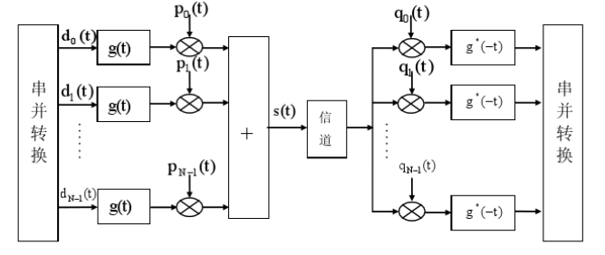
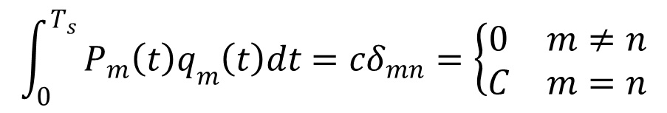
*Multiplexing : Orthogonal frequency division multiplexing (OFDM) technology

Slide 48
*Multiplexing : Orthogonal frequency division multiplexing (OFDM) technology
FFT based OFDM Transmit System
FFT based OFDM Receiving System

Slide 49
*Multiplexing : Orthogonal frequency division multiplexing (OFDM) technology
Advantages:
  Reduce the influence of inter-symbol interference;
  Reduce the effect of frequency selective fading;
  Improve the band utilization, to avoid the crosstalk between sub-channels;
  Nearly eliminate inter-symbol interference;
  Anti-interference coding technology can be used to effectively recover the error;
  The parallel data can be modulated and demodulated by discrete Fourier transform DFT, which reduces the complexity of system implementation.

Slide 50
*Multiplexing : Orthogonal frequency division multiplexing (OFDM) technology
Applications of OFDM technology:
  ADSL
  Digital Audio Broadcasting (DAB)
  HDTV
  Wireless LAN (WLAN)
  Broadband radio access network
  3G mobile communication network and other fields.

Slide 51
*Multiplexing : Wavelength division multiplexing (WDM)
  Transmission of multiple optical carriers with different wavelengths in a fiber at the same time
  WDM is actually a variant of FDM for fiber channel multiplexing.

Slide 52
*Multiplexing : TDMA
TDMA: time division multiple access
access to channel in "rounds"
each station gets fixed length slot (length = pkt trans time) in each round
unused slots go idle
example: 6-station LAN, 1,3,4 have pkt, slots 2,5,6 idle
6-slot
frame
6-slot
frame
1
3
4
1
3
4
Notes:
TDM (Time Division Multiplexing): channel divided into N time slots, one per user; inefficient with low duty cycle users and at light load.
FDM (Frequency Division Multiplexing): frequency subdivided.

Slide 53
*Multiplexing : TDMA
Classification of TDM
  Synchronous TDM:
    Time slice fixed allocation, suitable for fixed rate transmission
    The time slice of the physical channel is fixedly allocated to several users for data transmission, and each user uses the channel for data transmission when its corresponding time slice arrives.
  Advantages: simple implementation.
  Disadvantages: there is a waste of bandwidth.
  Synchronous TDM technology is suitable for fixed rate data communication system.

Slide 54
*Multiplexing : TDMA
Asynchronous TDM:
  The time slot of the physical channel is fixedly allocated for several, and the user does not occupy a certain time slice.
  When a user needs to carry out data transmission, to assign a time slice;
  If the user does not have the data transmission requirements, the system does not allocate the time slice to the user, the corresponding time slice can be allocated to other users.
Advantages: On-demand distribution of channel time slices, high utilization rate.
Disadvantages: complex implementation.
Asynchronous TDM technology is suitable for variable rate communication systems.

Slide 55
*Multiplexing : TDMA

Slide 56
*Multiplexing : Code Division Multiple Access (CDMA)
unique “code” assigned to each user; i.e., code set partitioning
  all users share same frequency, but each user has own “chipping” sequence (i.e., code) to encode data
  allows multiple users to “coexist” and transmit simultaneously with minimal interference (if codes are “orthogonal”)
encoded signal = (original data) X (chipping sequence)
decoding: inner-product of encoded signal and chipping sequence

Slide 57
*Multiplexing : CDMA encode/decode
channel output Z_{i,m}
Z_{i,m}= d_{i}.c_{m}
data
bits
d₀ = 1
1
1
1
1
1
d₁ = -1
1
1
1
-
-
-
-
1
-
-
-
1
-
1
1
1
1
1
sender
1
1
slot 1
channel
output
slot 0
channel
output
1
1
1
1
1
code
1
1
-
-
-
1
-
1
1
1
-
-
-
1
-
1
1
1
slot 1
slot 0
M
D_{i} = Σ Z_{i,m}.c_{m}
m=1
M
received
input
1
1
1
1
1
1
1
1
d₀ = 1
-
-
-
-
1
-
-
-
1
-
1
1
1
1
1
1
d₁ = -1
1
slot 1
channel
output
slot 0
channel
output
1
1
1
1
1
code
1
1
-
-
-
1
-
1
1
1
-
-
-
1
-
1
1
1
receiver
slot 1
slot 0

Slide 58
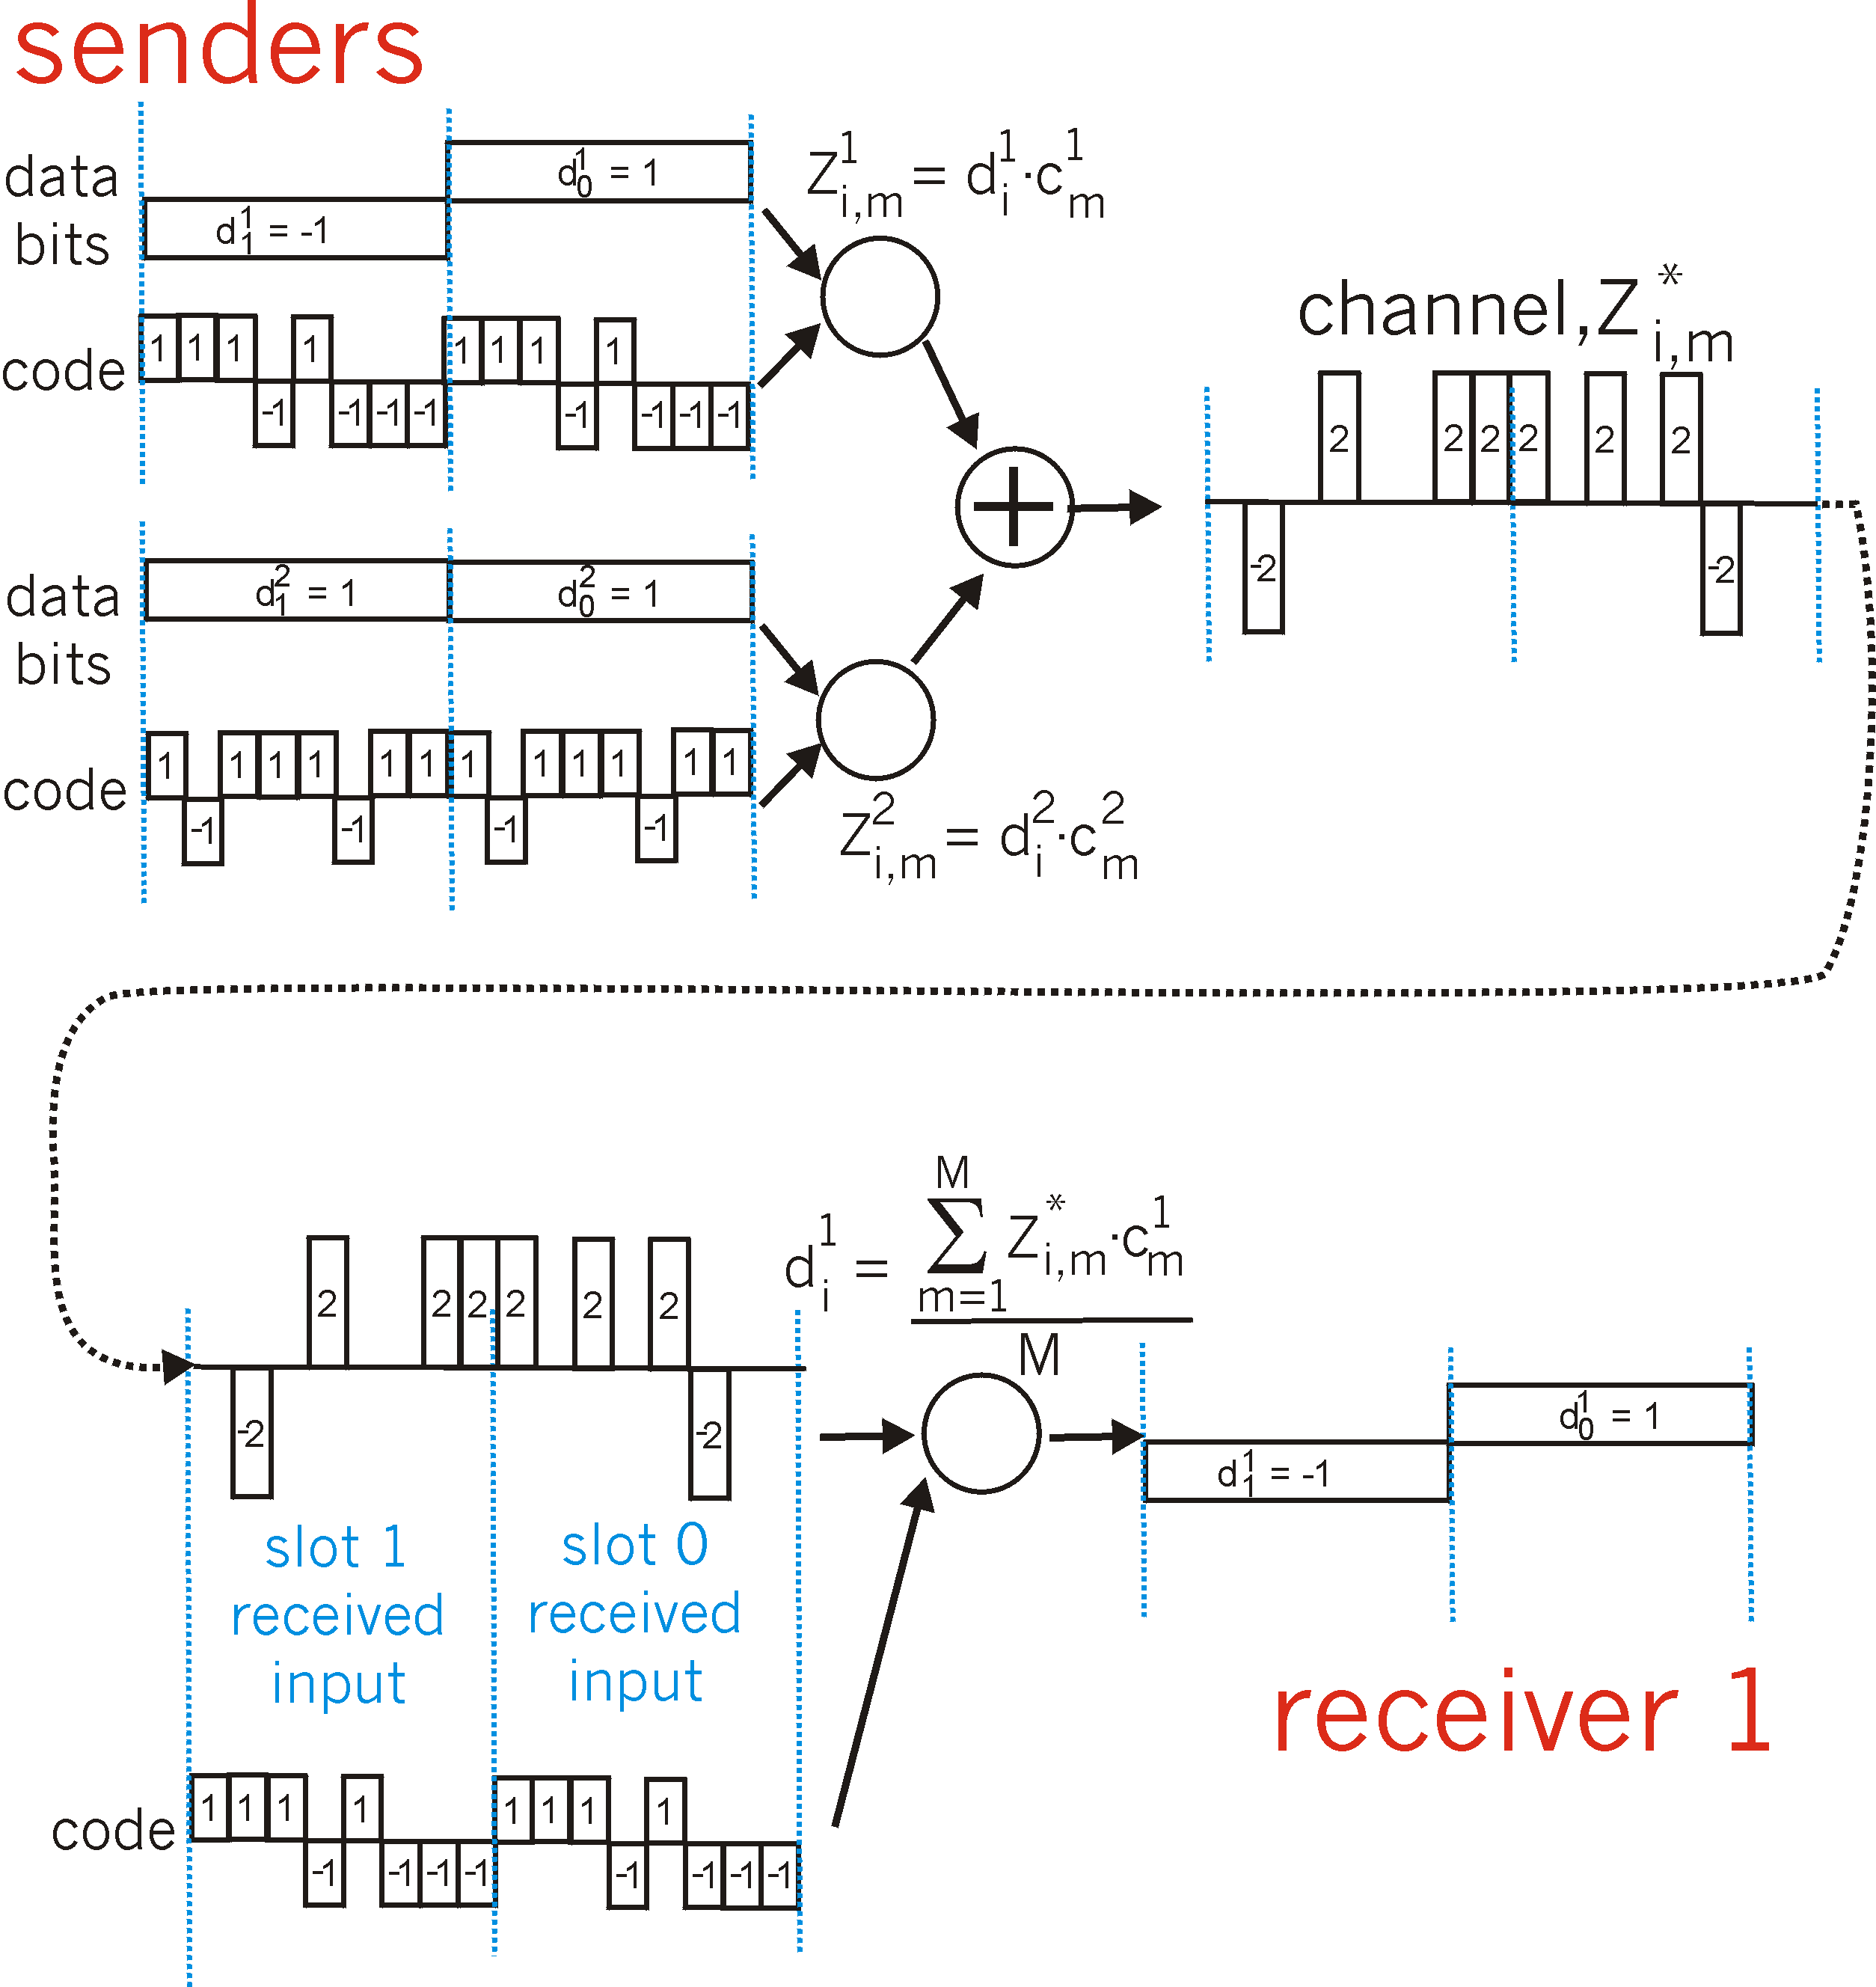
*Multiplexing : CDMA: two-sender interference
channel sums together transmissions by sender 1 and 2
Sender 1
Sender 2
using same code as sender 1, receiver recovers sender 1’s original data from summed channel data!

Slide 59
*Comparison of commonly used media
Transmission medium
Transfer method
Rate/
Band
Transmission distance
Performance
Price
Application
Twisted pair
Broadband
Baseband
≤1Gb/s
Anolog: 10km
digtal: 500m
Better
Low
Analog / digital signal transmission
50Ω
Coaxial cable
Baseband
10Mb/s
<3km
Better
Lower
Baseband digital signal
75Ω
Coaxial cable
Broadband
≤450MHz
100km
Better
Lower
Analog TV, data and audio
Optical fiber
Baseband
40Gb/s
20km以上
Very good
Higher
Long - distance high - speed data transmission
Microwave
Broadband
4-6GHz
Several hundred km
Good
Medium
Remote communication
Satellite
Broadband
1-10GHz
18000 km
Very good
High
Remote communication

Slide 60
*Commonly used physical layer interface standards
EIA-232-E interface standard
RS-449 interface standard
RS-485 interface standard
CAN interface standard
PROFIBUS interface standard
…….

Slide 61
Recap of the Physical Layer
The function of the physical layer and the issues to be considered
Four important characteristics of the physical layer
The contents of the physical layer protocol
Some Basic Concepts in Data Communication
Nyquist's Law and Shannon's Formula
Signal Coding Technology and Multiplexing Technology
Commonly used transmission medias
Commonly used physical layer interface standards

Slide 62
Exercise-1
In the physical layer interface characteristics, the time sequence used to describe the completion of each function is
A. Mechanical Characteristics
B. Electrical Characteristics
C. Functional Characteristics
D. Procedural Characteristics
2. Among the following options, that do not belong to the definition scope of physical layer interface specification is
A. interface shape B. pin function
C. physical address D. signal level

Slide 63
Exercise-2
Under the condition of no noise, if the frequency bandwidth of a communication link is 3kHz and QAM modulation technology with four phases and four amplitudes in each phase is adopted, the maximum data transmission rate of the communication link is
A. 12kbps B. 24kbps C. 48kbps D. 96kbps
2. If the data transmission rate of a communication link is 2400bps and 4-phase modulation is adopted, the baud rate of the link is
A. 600 baud B. 1200 baud
C. 4800 baud D. 9600 baud

Slide 64
Exercise-2
3. If the frequency bandwidth connecting R2 and R3 link is 8kHz and the signal-to-noise ratio is 30dB, and the actual data transmission rate of the link is about 50% of the maximum data transmission rate, the actual data transmission rate of the link is about
A. 8kbps B. 20kbps C. 40kbps D. 80kbps
2. Among the following factors, which will not affect the channel data transmission rate is
A. signal to noise ratio B. frequency bandwidth
C. symbol speed D. signal propagation speed

Slide 65
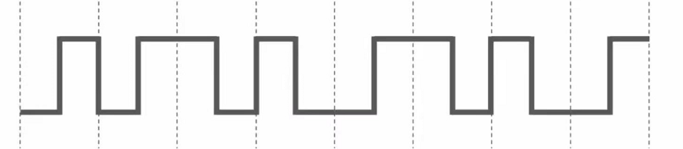
Exercise-3
If the following figure shows the signal waveform received by the 10Base-T network interface card, the bit string received by the network interface card is
A. 00110110 B. 10101101 C. 01010010 D. 11000101

